Slide 1
Azure Data Factory V2

Slide 2



Slide 3
Agenda
Background
Dive deeper into Azure Data Factory
Demo
Notes:
What is LoCD? A masterdata system for company data.

Slide 4
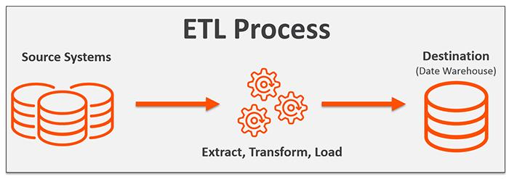
ETL

Slide 5
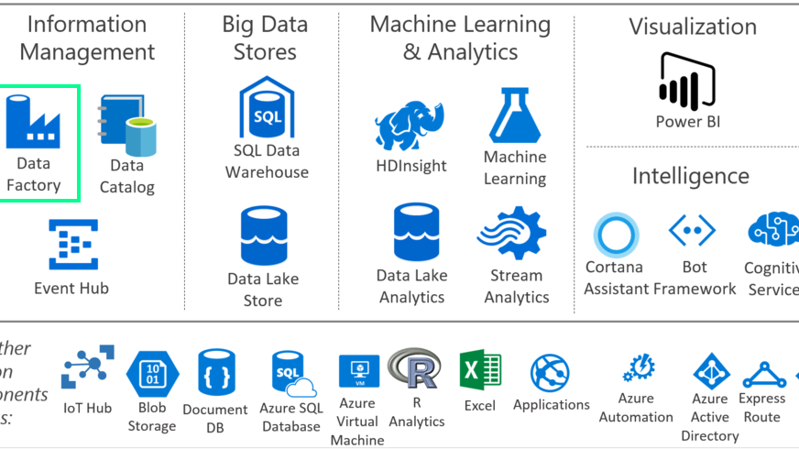
What is the Azure Data Factory?
Notes:
This is me buying into the Microsoft marketing department
Cortana intelligence suite - Grouping of services for managed Big Data and Analytics

Slide 6









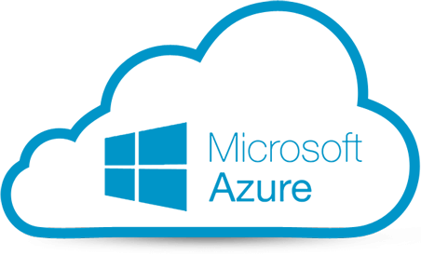
What is the Azure Data Factory?
“The Azure Data Factory service is a fully managed service for composing data storage, processing, and movement services into streamlined, scalable, and reliable data production pipelines”
=
+
Notes:
In Microsofts own words...
TO betThere is a concept called ETL
SSIS is stronger in ETL, where ADF is faster

Slide 7
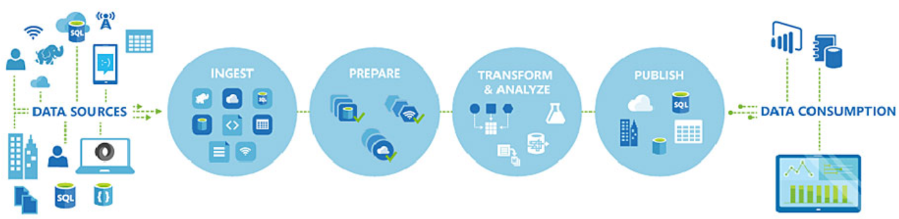
Typical usage of Azure Data Factory
Notes:
Read the data
Validation, basic mapping
Transform
Push to your instance of whatever

Slide 8
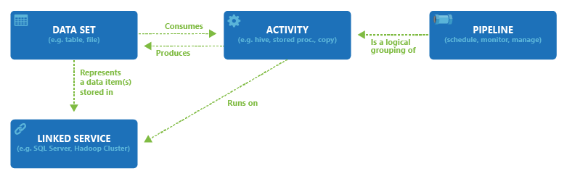
Concepts
Notes:
All activities in a pipeline are deployed, scheduled, or
deleted as one single unit instead of managing each
individual activity independently

Slide 9
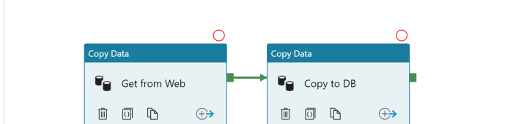
Activity
Is a component within a pipeline that performs a single action
Can copy data, perform lookups, do web request and execute stored procedure etc.
Linkable via dependencies such as OnSuccess, OnFailure, OnCompletion and OnSkip
Notes:
Copy data actions also do transformation

Slide 10
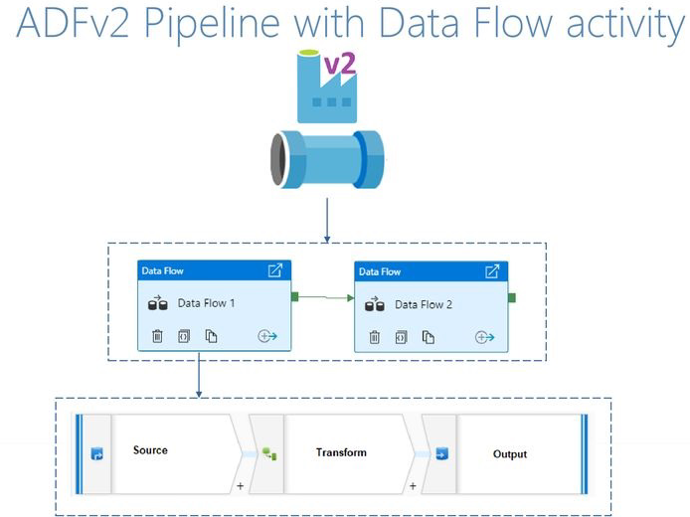
Azure Data Factory Pipeline
Different Data Source
integration
ETL/ELT

Slide 11
When to use ADF?
Create on demand or event triggered pipelines
Work with all my data across cloud and on-prem
Data movement at scale
Pipelines spanning services and servers
For when data integrators are not developers
For when you want to move your SSIS investments to the cloud

Slide 12
Q&A

